Slide 1
Vending Machine
Hardware Engineering
Stephanie Chinenye Okosa, Muhammed Umer Bin Yaqoob, Maxim Emile Speczyk

Slide 2
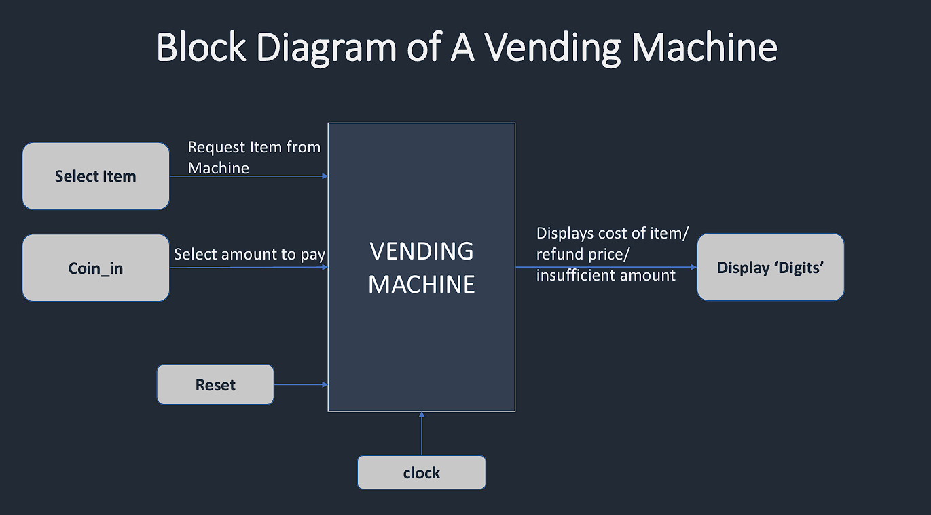
Concept

Slide 3
State machine
Idle
pickItem /= “0000”
Dispense = 0
selected
Coin_in /= “0000”
Coin_in = “0000”
Dispense = 0
review
Total > Price
output
Dispense /= 0

Slide 4
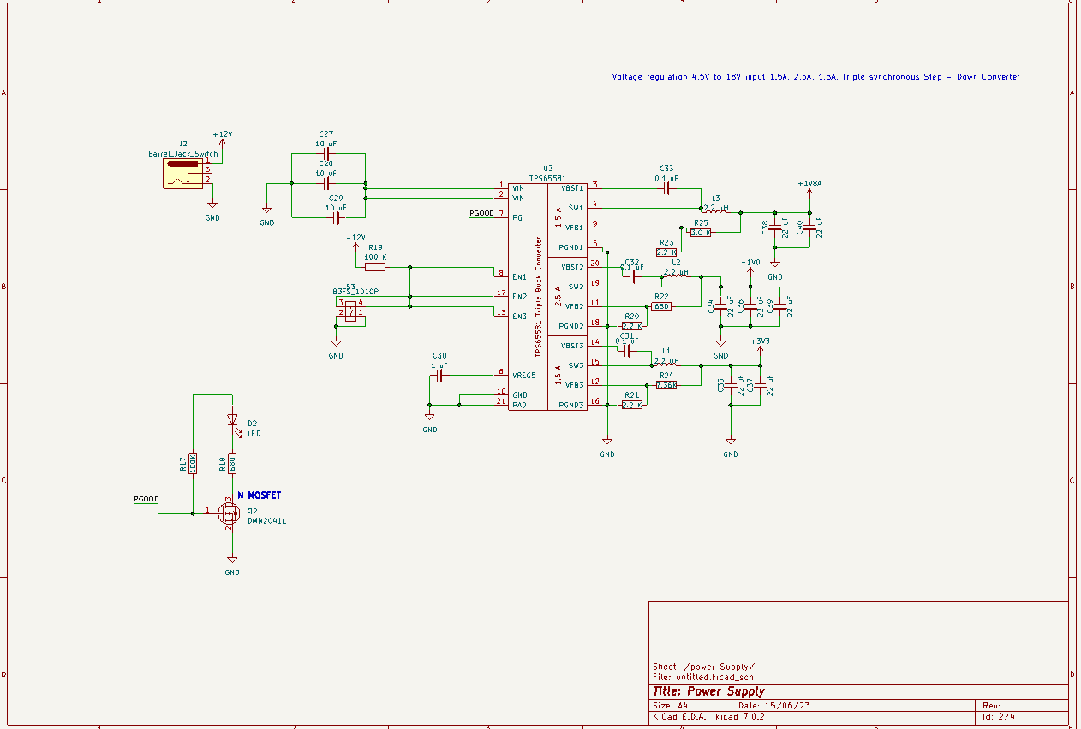
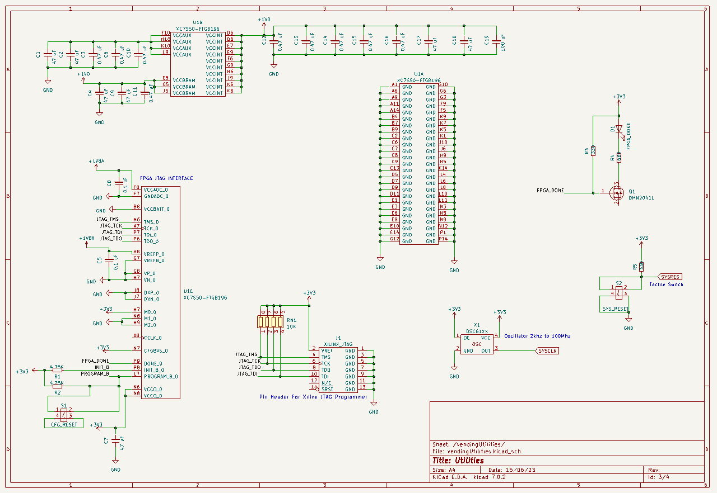
Circuit Power Supply & Utilities

Slide 5
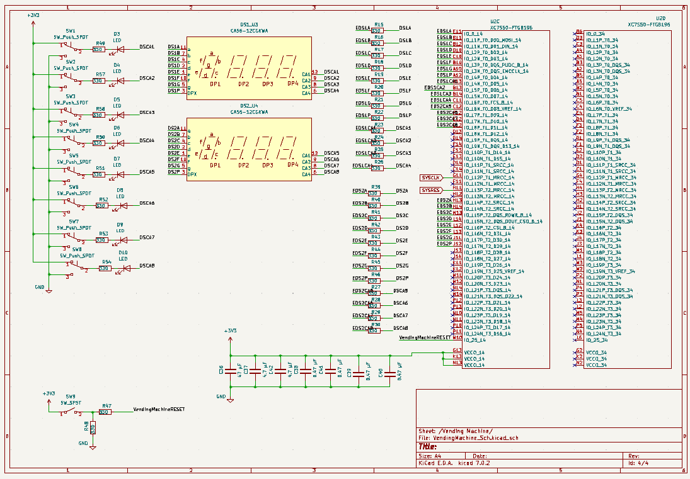
Circuit Vending Machine

Slide 6
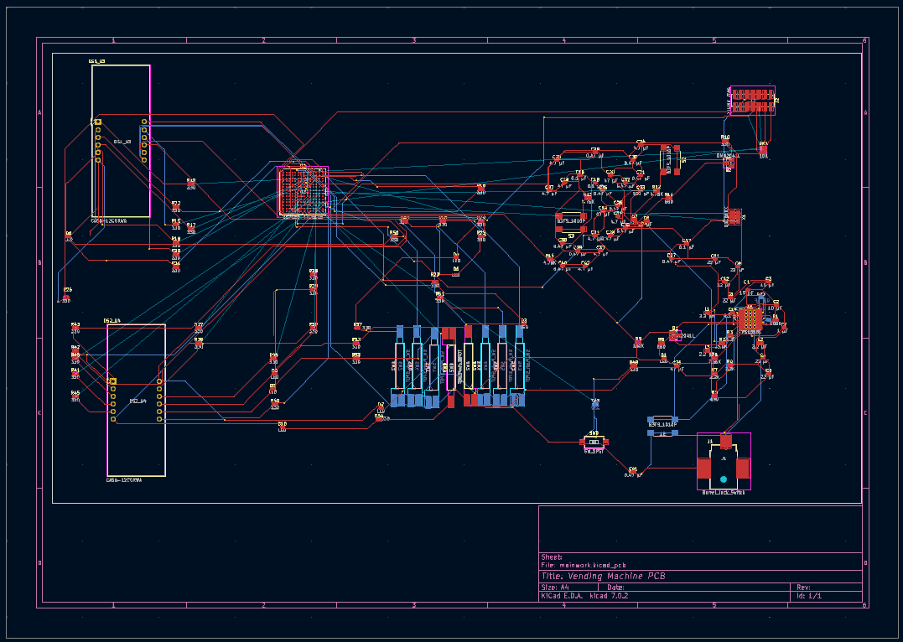
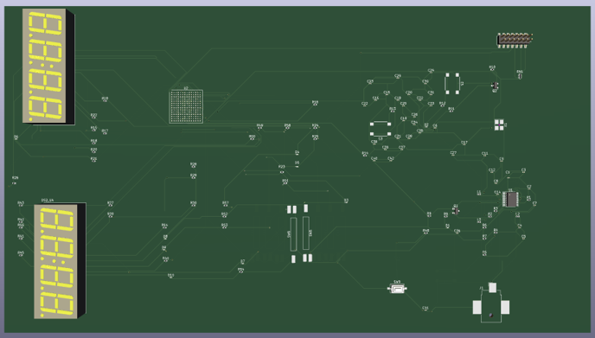
PCB

Slide 7
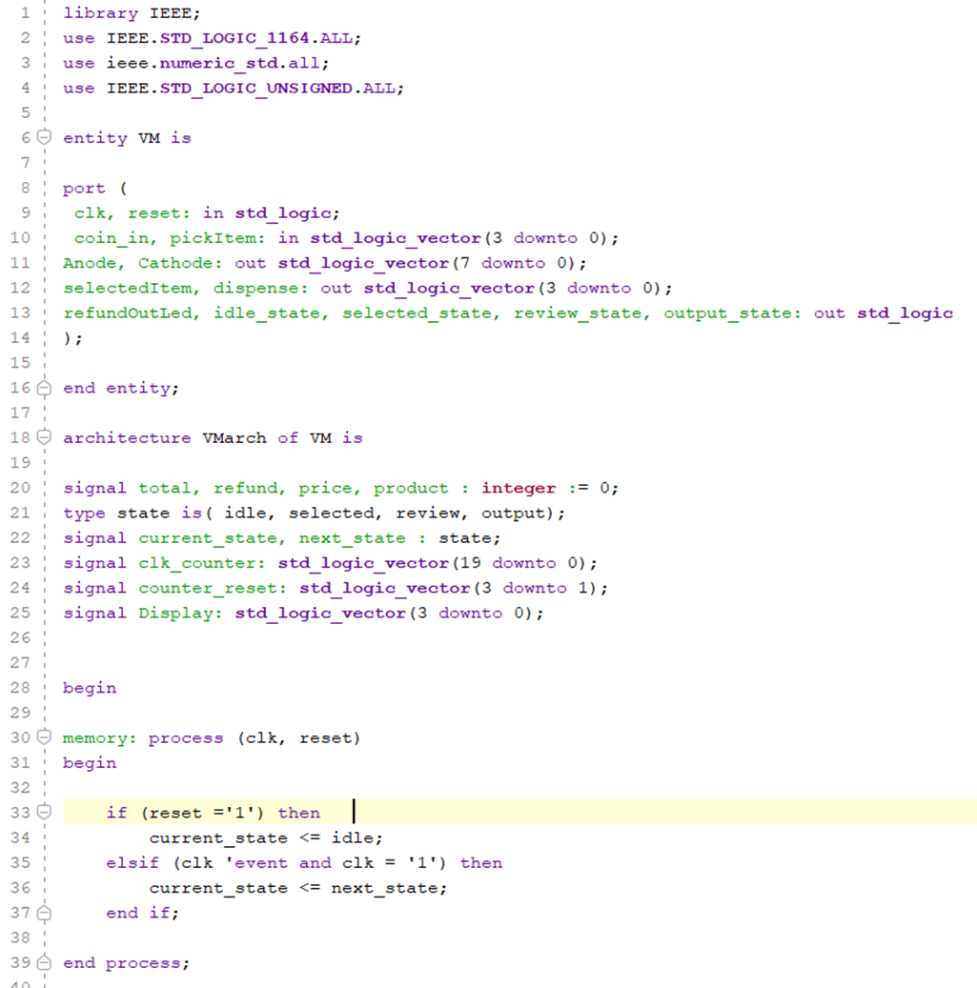
CODE

Slide 8
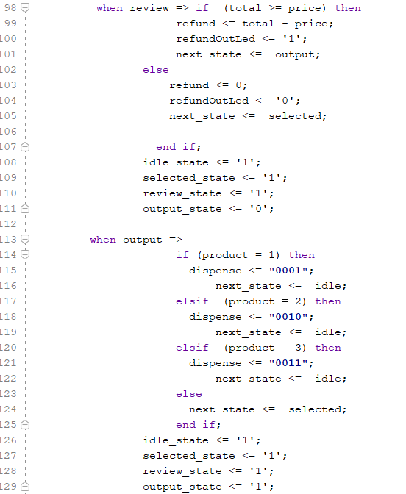
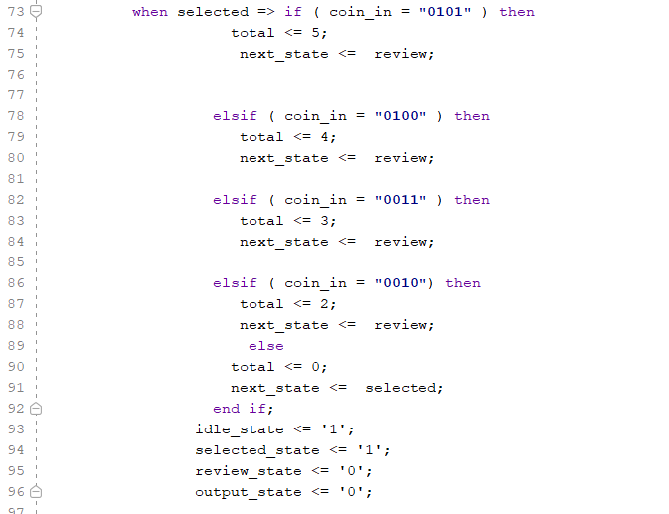
CODE

Slide 9
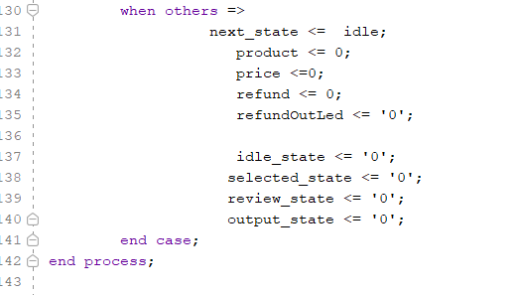
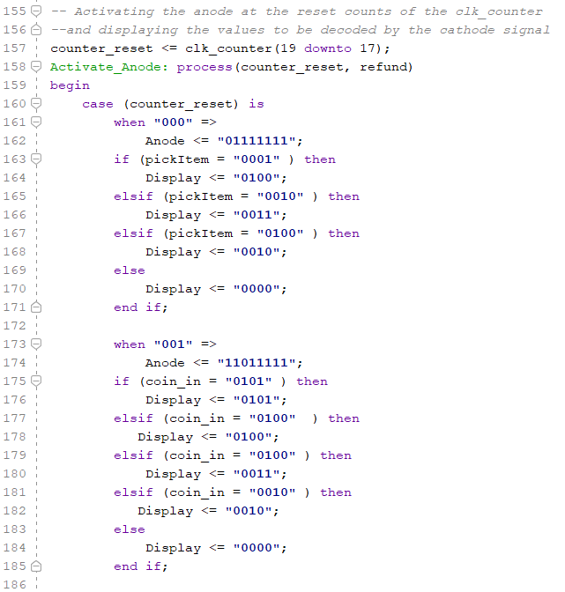
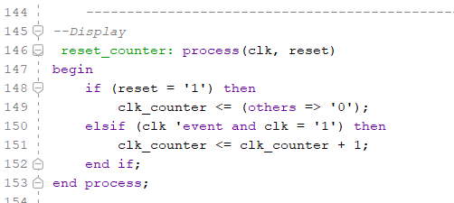
CODE

Slide 10
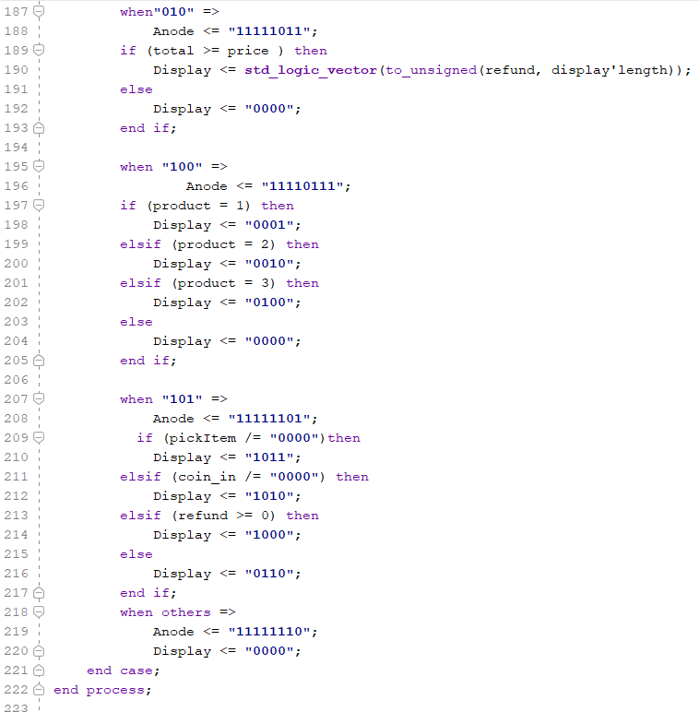
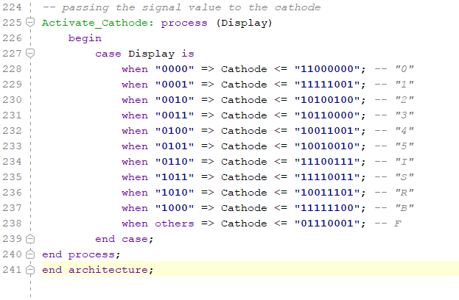
CODE

Slide 11
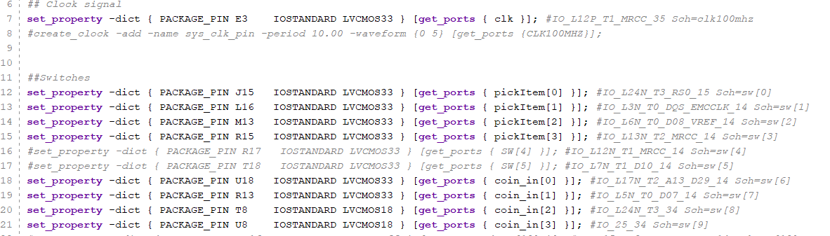
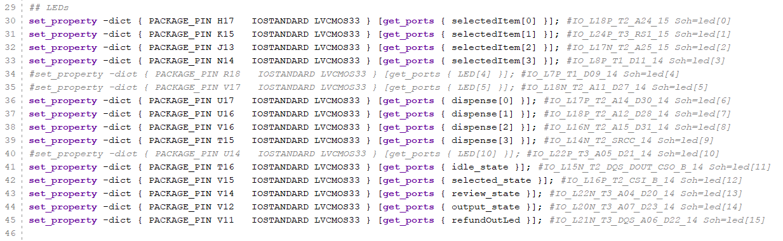
CONSTRAINT FILE

Slide 12
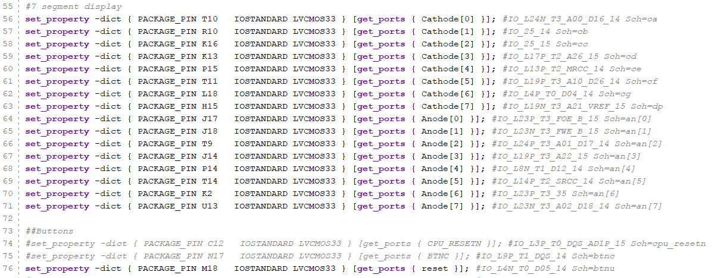
CONSTRAINT FILE

Slide 13
Let’s see it in action !

